Slide 1
Analyzing School Bus Breakdowns in NYC
Josh Podl

Slide 2
Overview
Many students in New York City rely on buses to get to and from school. Any delays or disruptions in service due to bus breakdowns has the potential to be detrimental to students’ learning experiences, and, ultimately, their educational outcomes.
I utilized the “Bus Breakdown and Delays” dataset from NYC Open Data to conduct my analysis. This dataset of over 700,000 rows and 21 columns contained line items for every school bus delay or breakdown in the last 10 school years. I focused in on only breakdowns (excluding delays) in Brooklyn, Manhattan, Queens, and the Bronx, trimming the data down to ~56,000 rows and the 7 columns that I leveraged in my analyses.

Slide 3
Different Lenses for Analysis
Where
When
How
Where do breakdowns happen?
Which boroughs experience a higher frequency of school bus breakdowns?
When do breakdowns happen?
What school years have featured more bus breakdowns? What time of day are breakdowns more likely to occur?
How is communication handled?
Do bus contractors notify schools and/or parents of bus breakdowns?

Slide 4
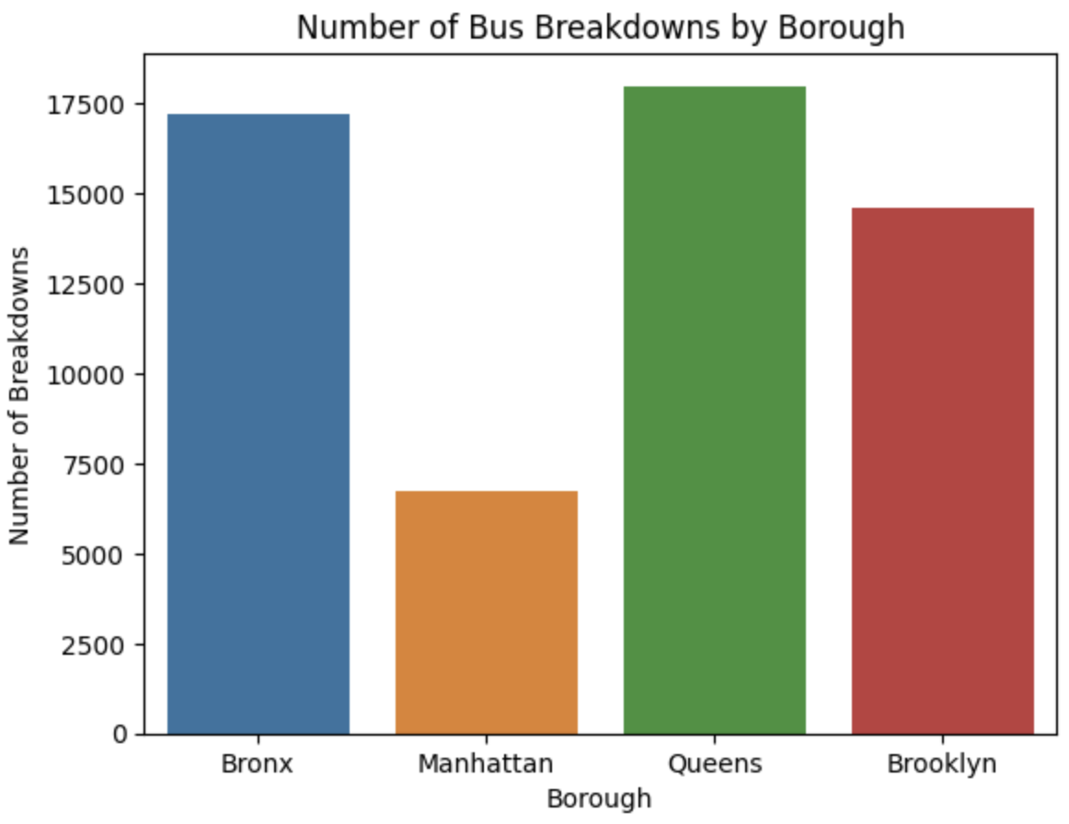
Where
Bus breakdowns are most common in Queens (17,995) and in the Bronx (17,228). Fewer breakdowns in Brooklyn (14,582) and Manhattan (6,736).
35
25
22
15

Slide 5
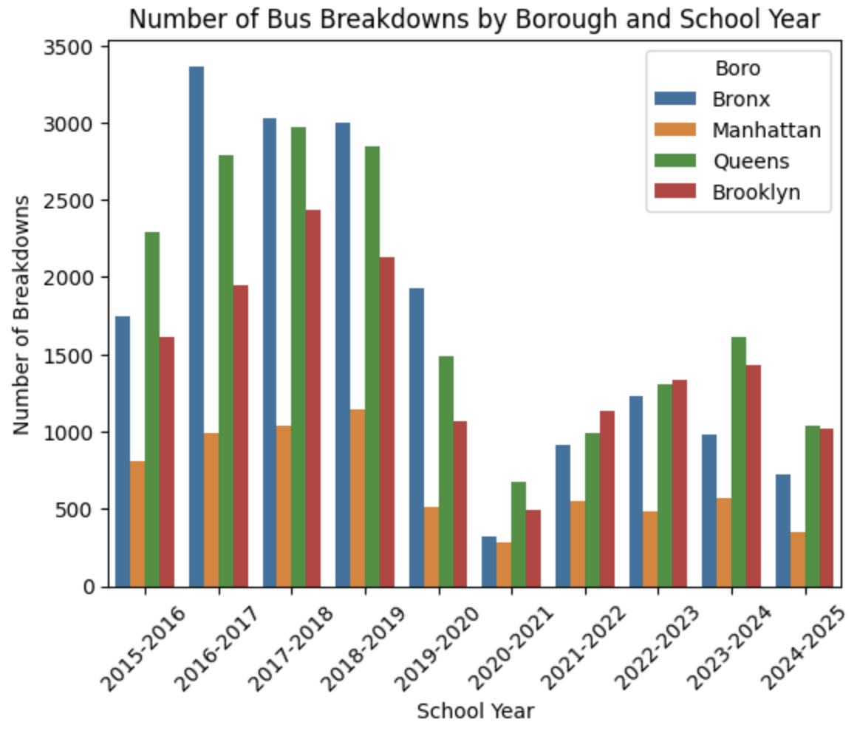
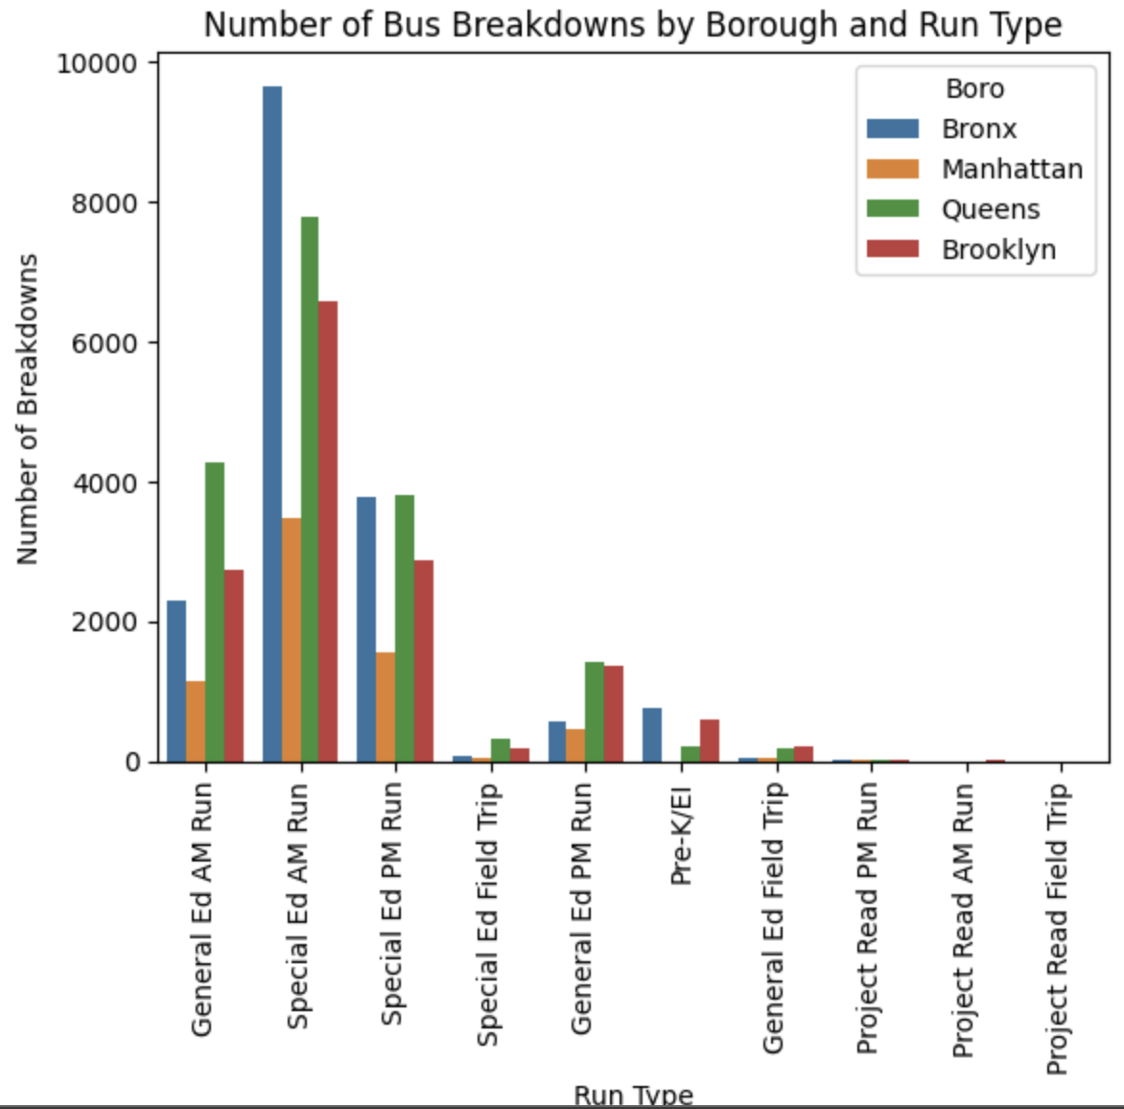
When
Bus breakdowns were most frequent in the years prior to the onset of the pandemic. Average 8,530 per year from 2015-2016 to 2018-2019 compared to 4,022 from 2022-2023 to 2024-2025.
The majority of breakdowns occurred in the morning (67%), which likely led to students arriving to school late.
35
25
22
15

Slide 6
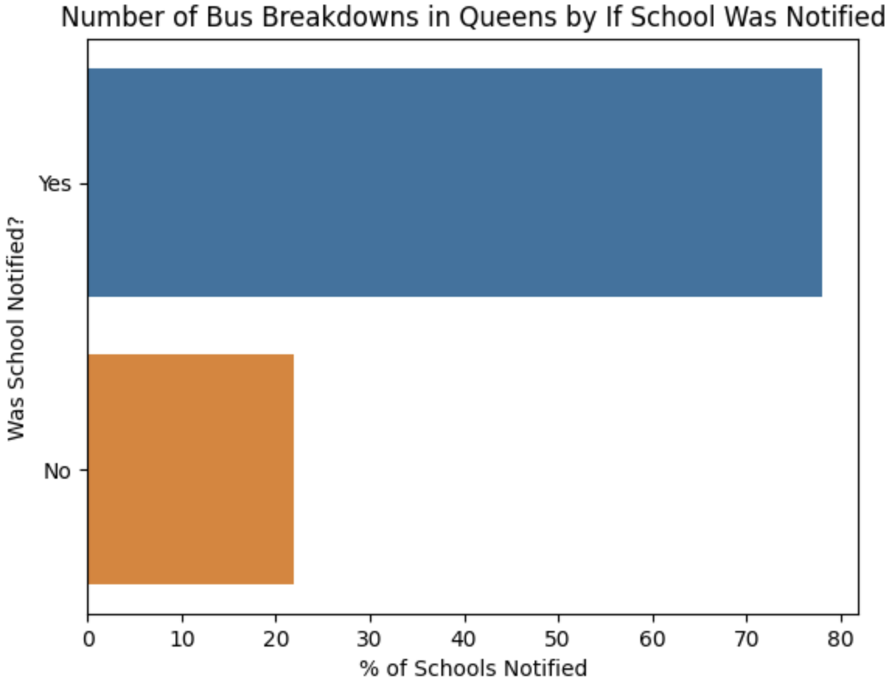
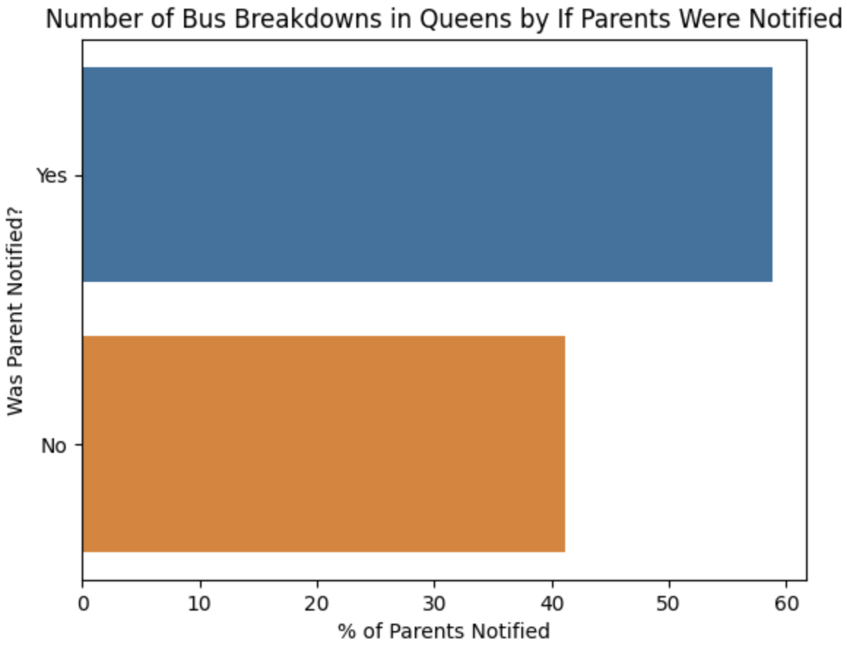
How
More often than not, school bus contractors notify both schools and parents of bus breakdowns. Schools (78% in Queens) are more likely to be informed of breakdowns than parents (59% in Queens).
35
25
22
15

Slide 7
Conclusions
School bus breakdowns have been occurring half as often in the last few years compared to the late 2010s
Queens and the Bronx have consistently had more bus breakdowns than Brooklyn and Manhattan, with Manhattan having by far the fewest
Bus breakdowns are considerably more common in the morning, which can be disruptive to students’ attendance
It would be interesting to look at bus delay/breakdown data at a school district level and compare it to an education proficiency dataset
Do students at schools that experience more bus delays/breakdowns tend to achieve lower scores on standardized tests?

